Slide 1

Data Science Job Salaries
By-
(Group-2)
Komal Sakhare (112)
Aditya Ramtekkar(126)
Kapil Katariya (170)

Slide 2

Contents :
Introduction
Methodology Applied
Result and Discussion
Conclusion
Future scope
Notes:
© Copyright Showeet.com – Free PowerPoint Templates

Slide 3

Introduction
This is our Data Science Graphical Data Analysis with R project on data science job salaries conataning 8 Different Attributes.
In this we will analysis this data to do some exploratory data analysis along with data visualization to have a better understanding of the dataset to do future predictions if possible.
Graphs are useful for non-numerical data, such as colours, flavours, brand names, and more. When numerical measures are difficult or impossible to compute, graphs play an important role.
Various types of plots drawn in R programming are :
Plots with Single Variables
Plots with Two Variables
Plots with Multiple variables.
Special Plots
Notes:
© Copyright Showeet.com – Free PowerPoint Templates

Slide 4

Methodology Applied (page-1)
In this salary dataset , the different methods used to draw the graphs are :
Firstly we need to install two packages using the command ,
Install packages(“tidyverse”)
Install packages(“ggplot2”)
2. The next step is to import the dataset used , for this first we need to save the dataset file with .xlsx extension , then we need to import the data in our R studio file by clicking on the environment and then click on import dataset and import our excel file .
3. Now as the data has been imported , we’ll read the data by using read _ xlsx () function
Ex- data1 <[- read _x lsx(“path and name of dataset”)
4. For getting the summary of our dataset we use function summary(dataset _ name)
5. As specified in the dataset , we can take different values of x and y as the column names of our dataset for comparison and to get the inference from it.
Notes:
© Copyright Showeet.com – Free PowerPoint Templates

Slide 5

Methodology Applied (page-2)
6. Now we will begin with our coding part , first we need to read the library i.e library(ggplot2),to draw a graph the following code is used: ggplot (data1, aes(x= __ , y= __ , fill=factor(__))) + graph _ name ()
7. Here the graph name can be any graph which we want to use according to our need for the dataset.
8. Graphs like geom _ bar , geom _ point , for piechart we use pie ad for histogram we use hist.
9. Using the same code mentioned above we can draw different graphs by changing the value of x and y and specifying the graph required.
10. Lastly by observing and studying the graph we will get our required output and inference for our dataset.
Notes:
© Copyright Showeet.com – Free PowerPoint Templates

Slide 6
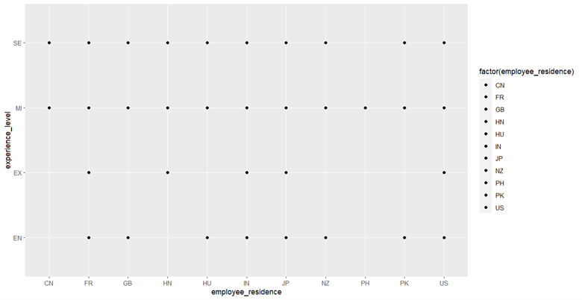
result and Discussion
(page -1)
1. Employees at Canada have only Medium-level and senior level employees. Whereas employees at Philippines have only Medium-level employees.
2. Countries like France, India, Japan and US have all types of employees i.e. EN, EX, MI, SE.As these countries have all types of employees in terms of experience hence probability of getting a job increases in this countries.
3. Similarly employment possibilities are low in Philippines as most of the people working there are only medium-level experienced employees.
6
Notes:
© Copyright Showeet.com – Free PowerPoint Templates

Slide 7
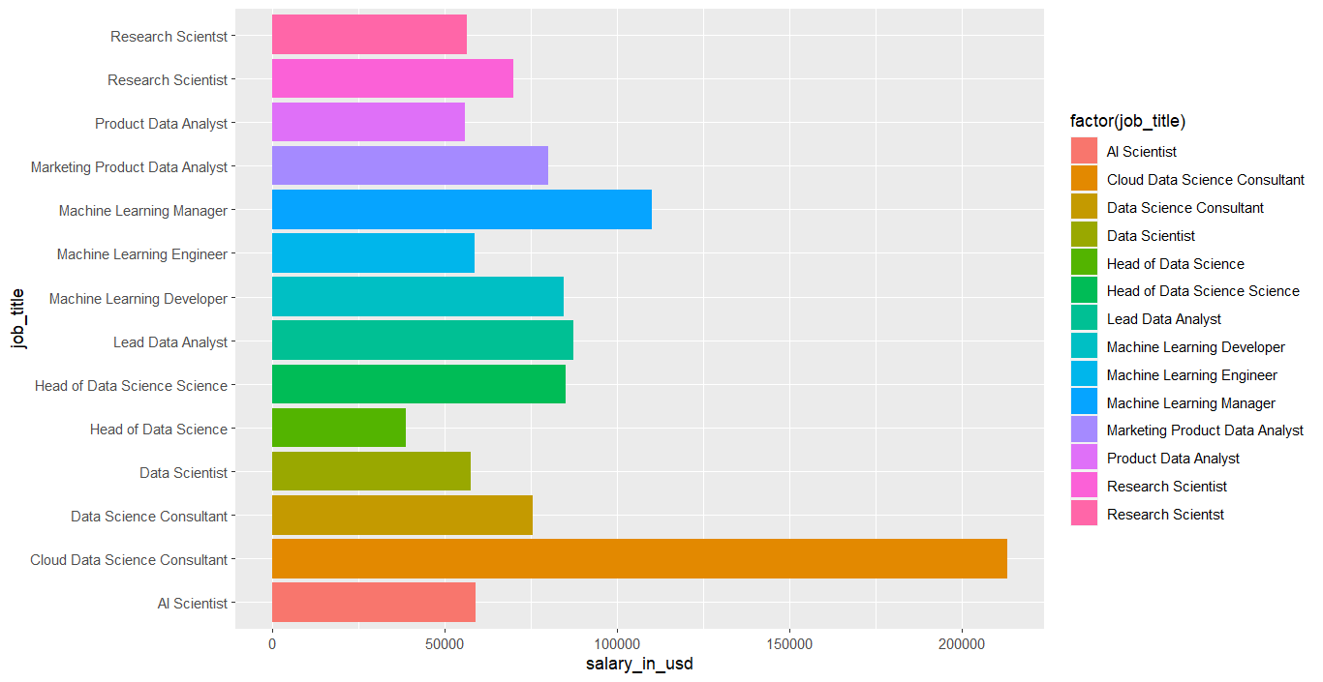
result and Discussion
(page -2)
1. As from the graph it is clearly visible that most of the data lie towards the left side hence it’s negatively skewed.
2. Head of Data science seems to have the lowest salaries of around $40000 whereas cloud data science consultants have the highest salaries of more than $200000.
3. As we are moving towards the generation of Meta verse hence the knowledge of cloud based services are having much more importance. People who are confused in choosing their field must go for cloud services.
.
Notes:
© Copyright Showeet.com – Free PowerPoint Templates

Slide 8
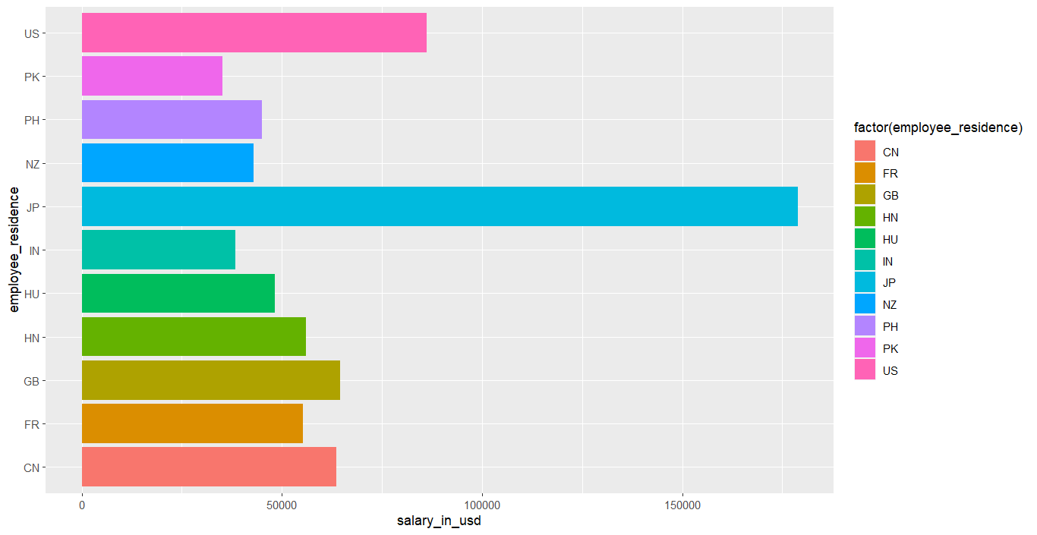
result and Discussion
(page -3)
1. As from the graph it is clearly visible that most of the data lie towards the right side hence it’s positively skewed.
2. People of japan earns the highest salary followed by US.
3. Pakistan seems to get the lowest salary, most of the people who are willing to go in data science field will migrate from PK to either JP or US in order to get more recognition and value.
Notes:
© Copyright Showeet.com – Free PowerPoint Templates

Slide 9
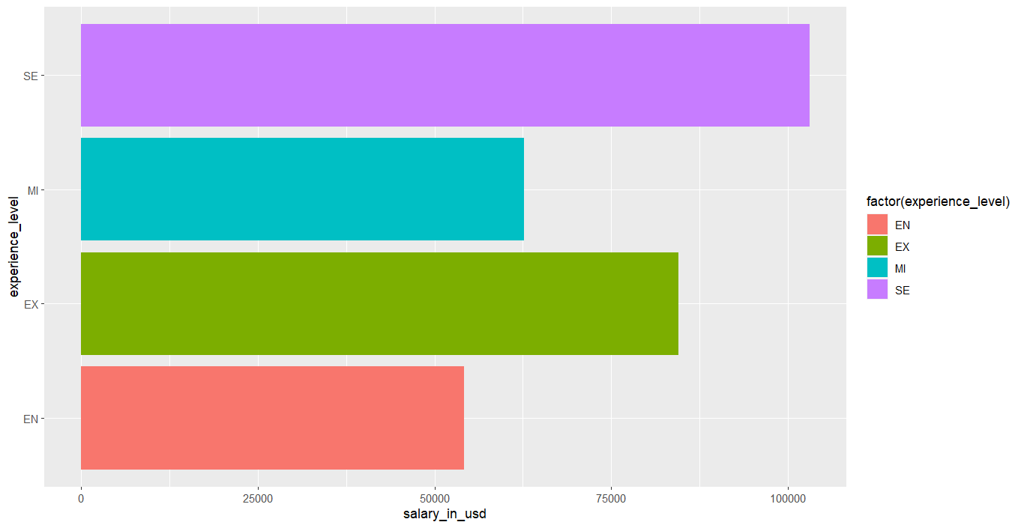
result and Discussion
(page -4)
All seeking for data science as their career must expertise and get your experience level to Senior Executive to be at the top level.
Notes:
© Copyright Showeet.com – Free PowerPoint Templates

Slide 10
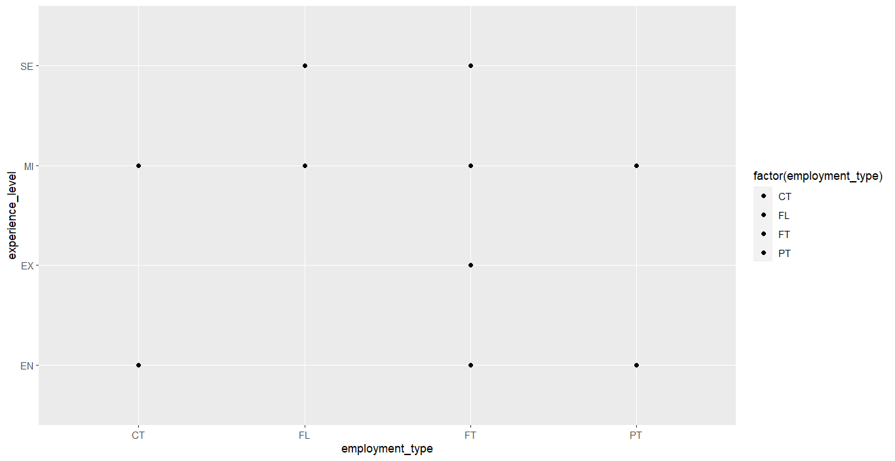
result and Discussion
(page -5)
From the graph we can say that Contract based jobs are preffered by entry level and mid level employees .
While Freelancers are prefferd by mid level and senior level employees.
almost all people prefer working full time irrespective of their levels.
Whereas Part time work is done by entry level and mid level employees.
Notes:
© Copyright Showeet.com – Free PowerPoint Templates

Slide 11
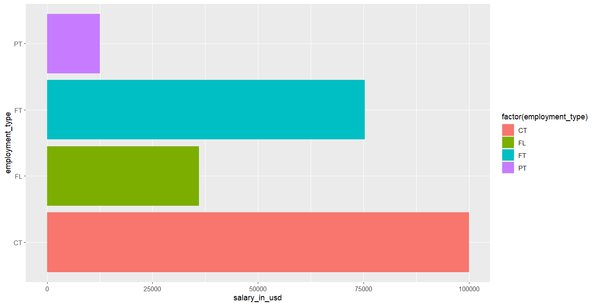
result and Discussion
(page - 6)
1As from the graph it is clearly visible that most of the data lie towards the left side hence it’s negatively skewed.
Employees working as part time has the least salary which is very much understandable as there are only working for few hours so they are paid less too.
Employees working on contract based duration has the highest salary as they are also the ones who are more experienced and skilled compared to others.
.
Notes:
© Copyright Showeet.com – Free PowerPoint Templates

Slide 12
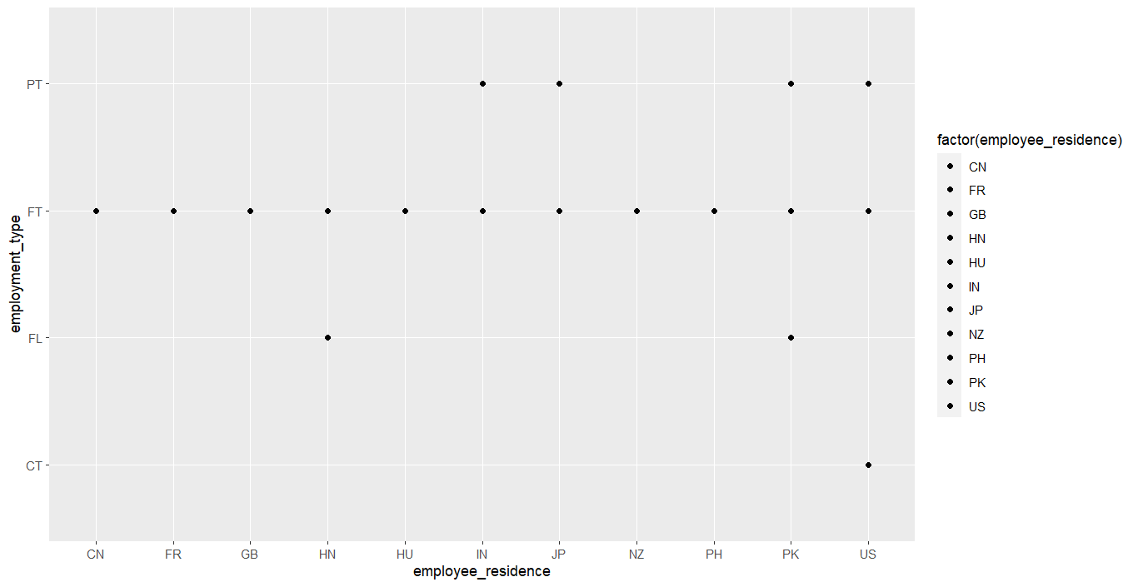
result and Discussion
(page -7)
From the graph we can say that almost all people prefer working full time irrespective of their residence.
If anyone is looking to work as a data scientist they must go for full time as they are also the second highest paid. Also after gaining a decent a amount of experience and knowledge they can apply for contract base employment where they are paid even more than the ones working full time.
.
Notes:
© Copyright Showeet.com – Free PowerPoint Templates

Slide 13

Conclusion
From the graphs our analysis says that the designation of a cloud data scientist consultant is the highest among all the fields available in data science sector . Countries like India , Japan, US have all kind of workers from beginers to expert level which results in high employee ability in this countries Employees working as part time has the least salary which is very much understandable as there are only working for few hours so they are paid less too. Employees working on contract based duration has the highest salary as they are also the ones who are more experienced and skilled compared to others.
Notes:
© Copyright Showeet.com – Free PowerPoint Templates

Slide 14

Future Scope
Countries like France, India, Japan and US have all types of employees i.e. EN, EX, MI, SE.As these countries have all types of employees in terms of experience hence probability of getting a job increases in this countries.
As we are moving towards the generation of Meta verse hence the knowledge of cloud based services are having much more importance. People who are confused in choosing their field must go for cloud services.
Pakistan seems to get the lowest salary, most of the people who are willing to go in data science field will migrate from PK to either JP or US in order to get more recognition and value.
If anyone is looking to work as a data scientist they must go for full time as they are also the second highest paid. Also after gaining a decent a amount of experience and knowledge they can apply for contract base employment where they are paid even more than the ones working full time.
Notes:
© Copyright Showeet.com – Free PowerPoint Templates

Slide 15



THANK YOU
By –
Komal Sakhare -112
Aditya ramtekar-126
Kapil katariya -170

